Slide 1


WEB SCRAPING TO GAIN COMPANY INSIGHTS
17/04/2023
85%
50%

Slide 2

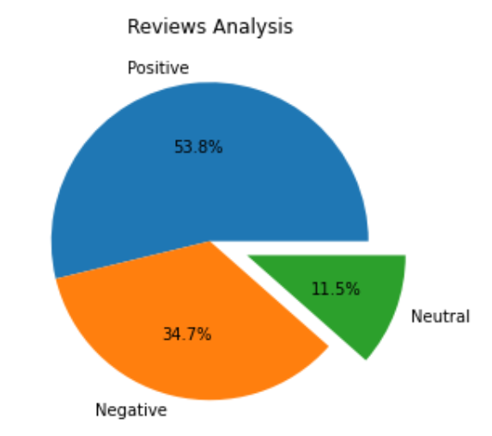
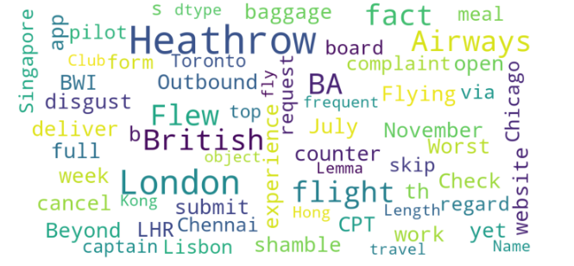
INSIGHTS FROM CUSTOMER REVIEWS

Slide 3
Web Scraping To Gain Company Insights
THANK YOU

